Slide 1




CONVERSATIONAL AI
DAB106 Section 001
Group Number : 05
Team Member: Asif Ahmed, Ayushi Patel, Jay Prajapati, Neha Kumari, Veera Santhosh

Slide 2
PROBLEM STATEMENT
Immediate customer service at low cost
Increase in waiting time for the customers, which restricts the Hotel’s business
Handling multiple customers at a time requires lot of human resources adding to the overall operational cost
Unpleasant customer experience due to human error

Slide 3
PROJECT PROPOSAL
The objective of this project is to design a chat bot based on conversational AI
It will act as a customer service representative and will be able to handle multiple customer queries
It will provide accurate information and will reduce human error
Its responses can be tweaked based on the business requirements
It can be link with multiple online communication channels like : Microsoft teams, Whatsapp, Linkedin, Skye etc.

Slide 4
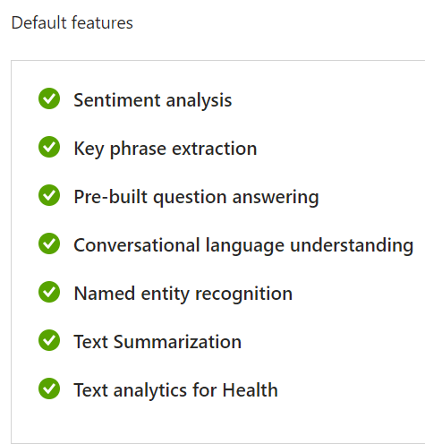
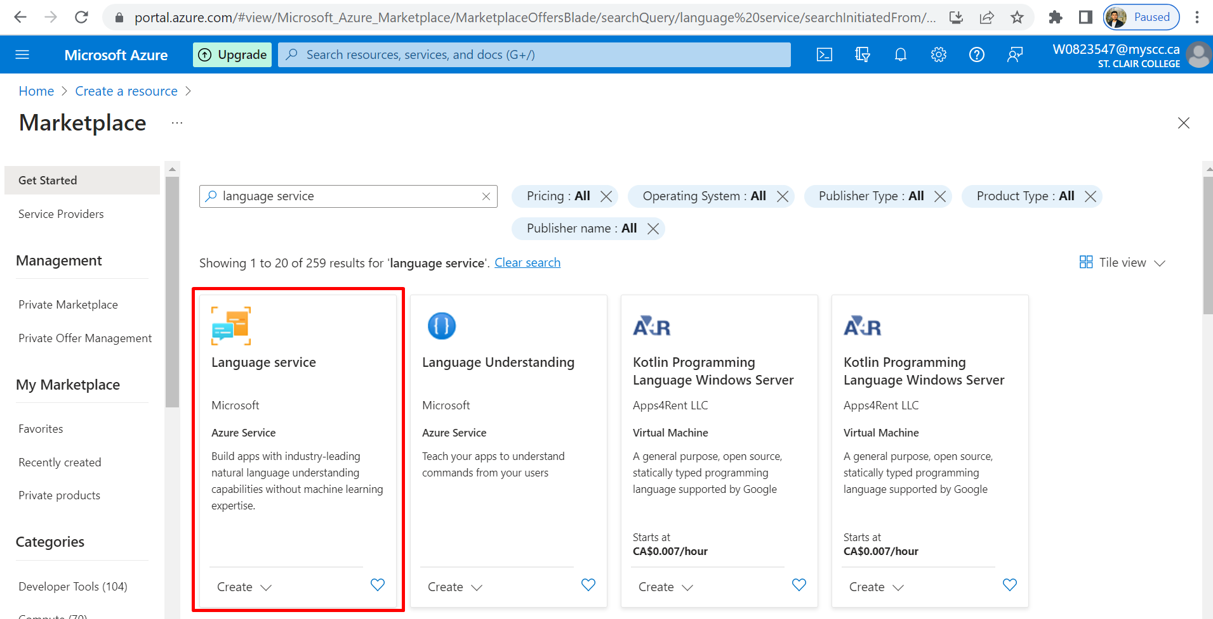
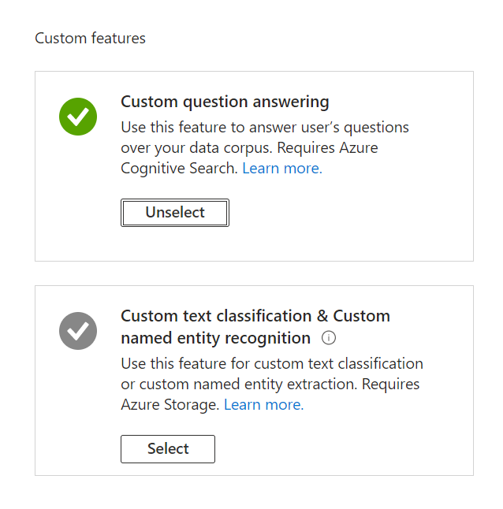
STEPS FOR CREATING A BOT
1
2
1. Initial step is to create a resource using Language service
2. There are some default features of the language service and few of them you can customize as per your requirements

Slide 5
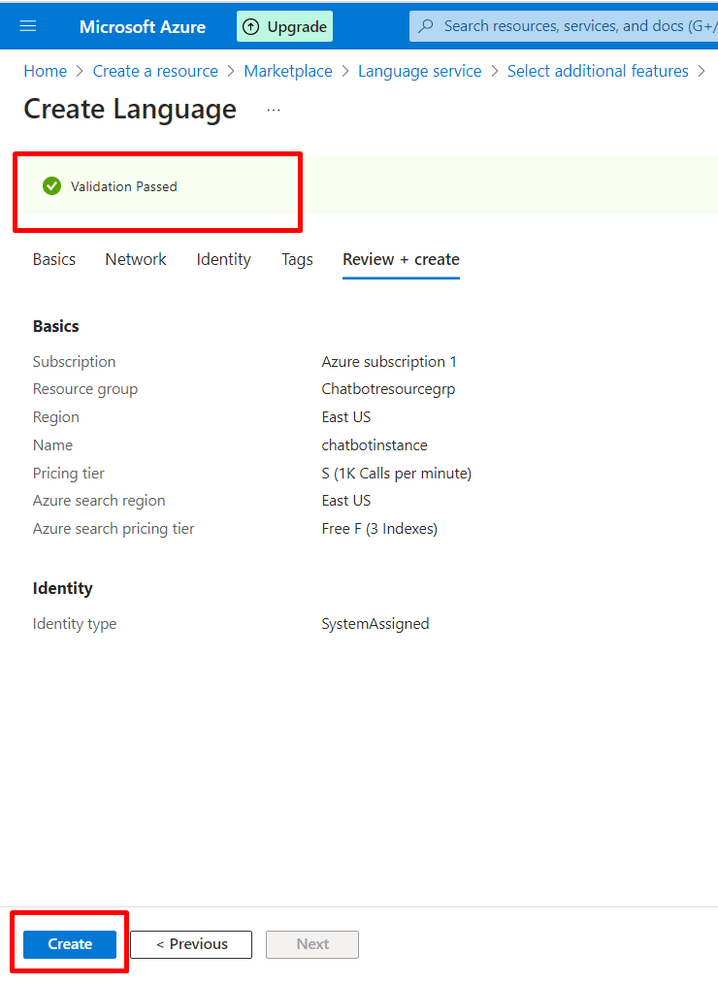
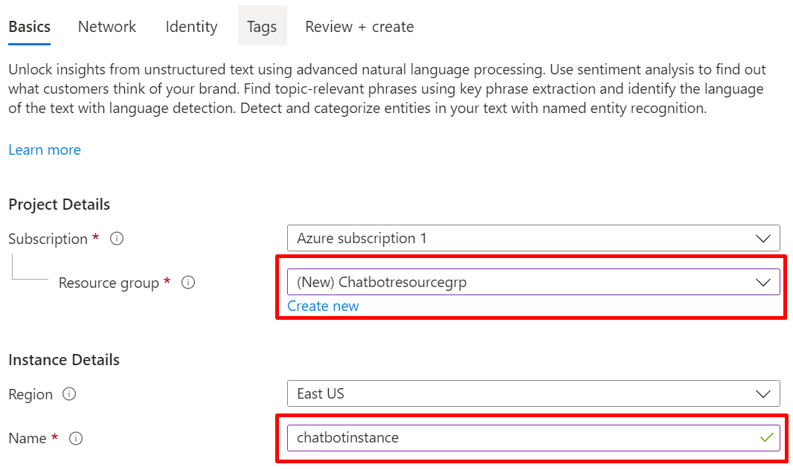

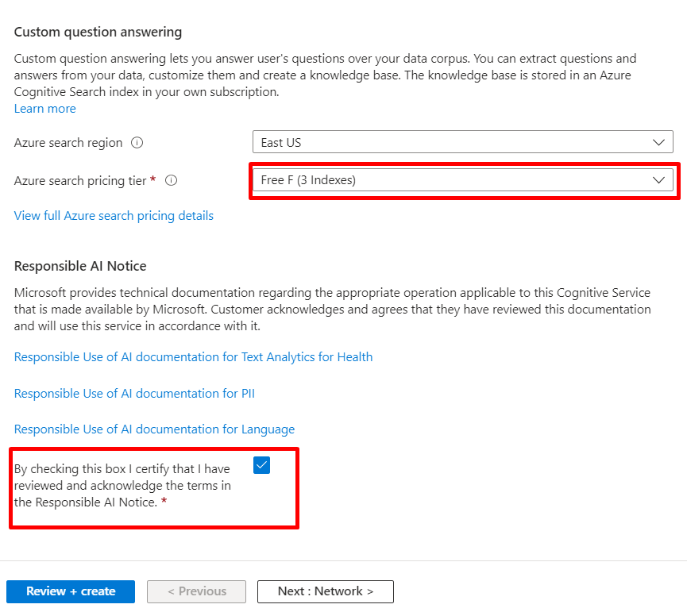
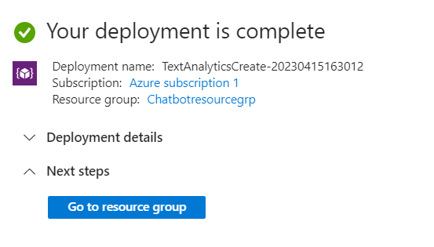
3
4
4. Once you passed the validation, click the create button
3. You need to mention your project details like resource group, instance, pricing tier. And hit the check box
5

Slide 6
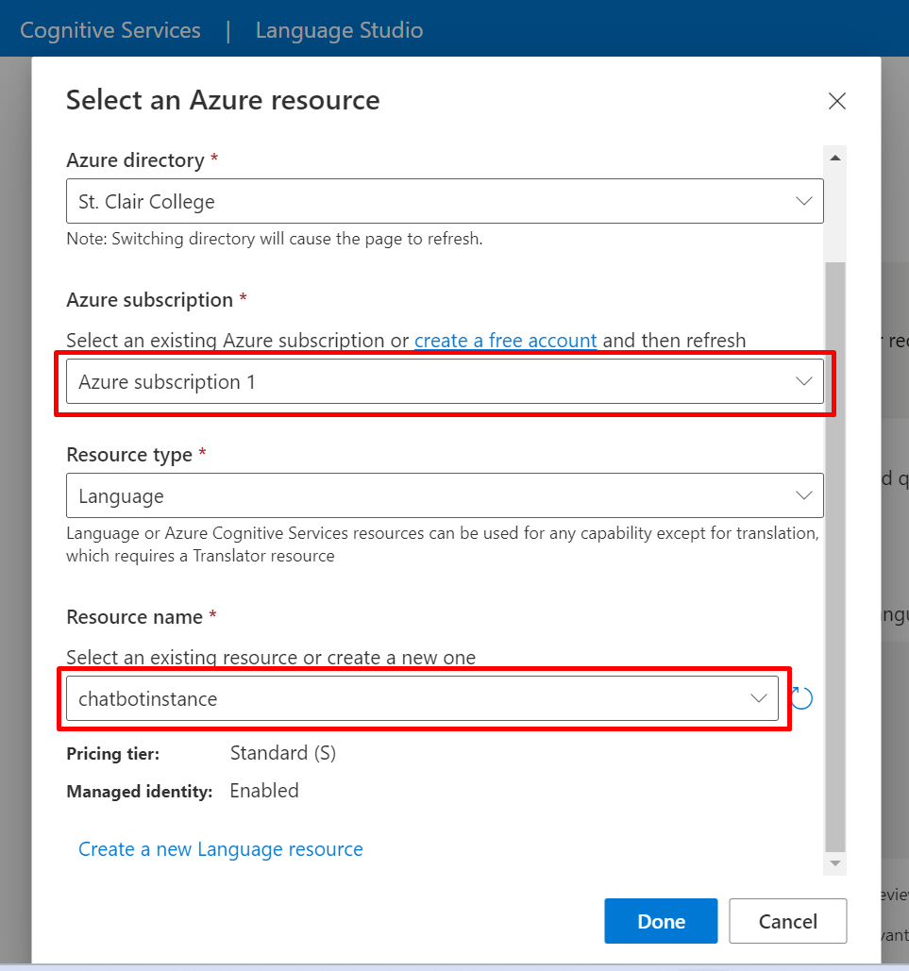
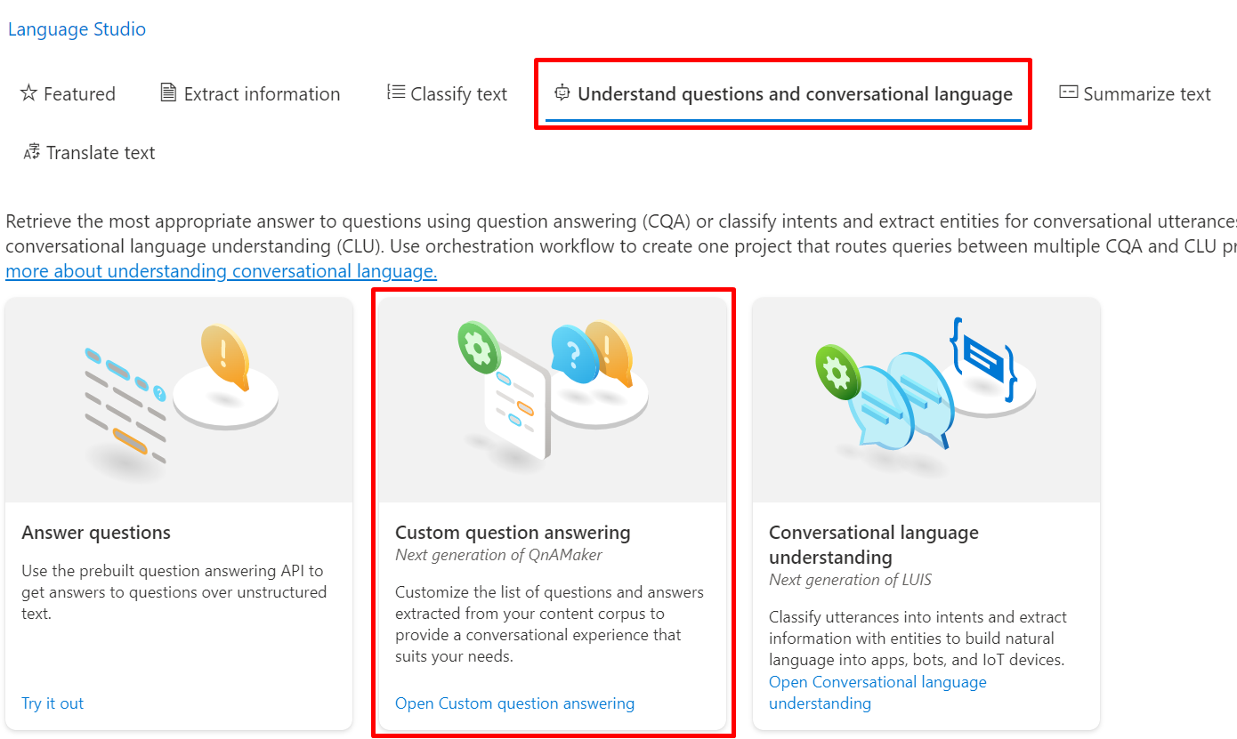
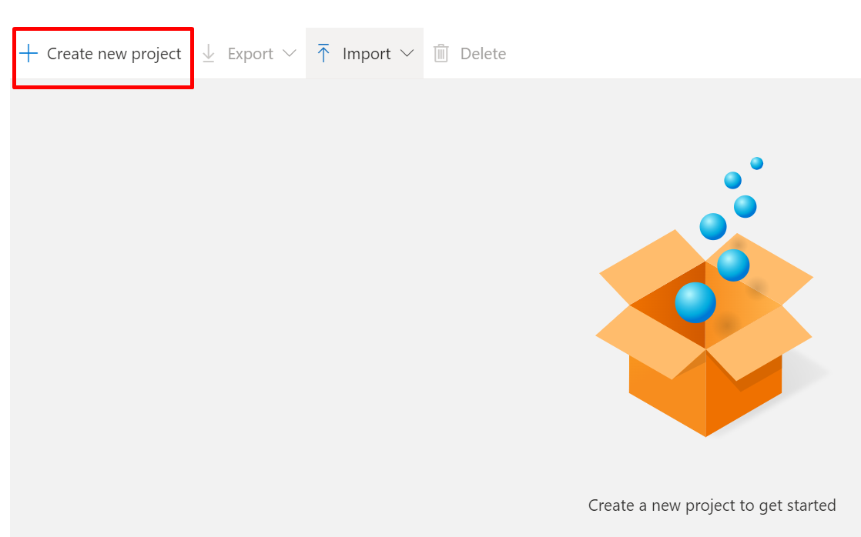
LANGUAGE STUDIO
6
7
6. Go to Language studio and select an Azure resource after filling the basic details
7. Then under ‘understand questions and conversational language’ tab, select ‘custom question answering’ and open it
8. Select ‘create new project’
8

Slide 7
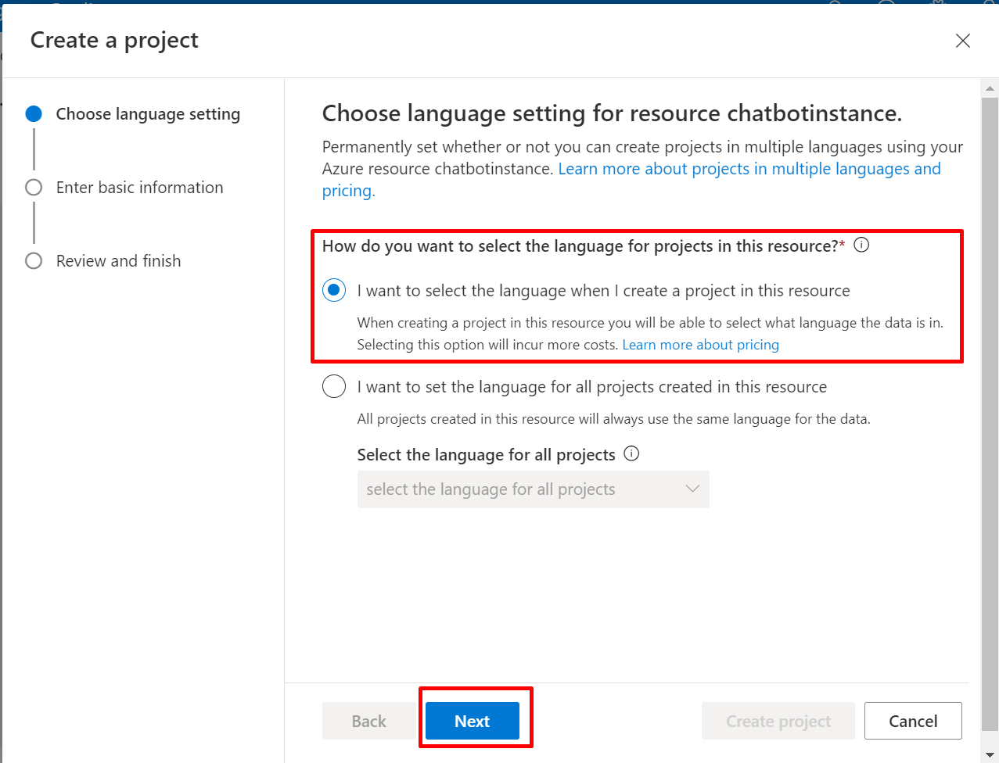
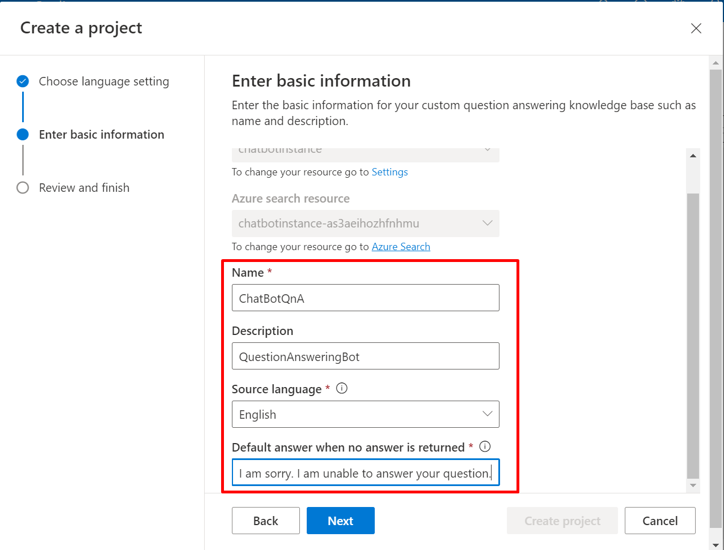
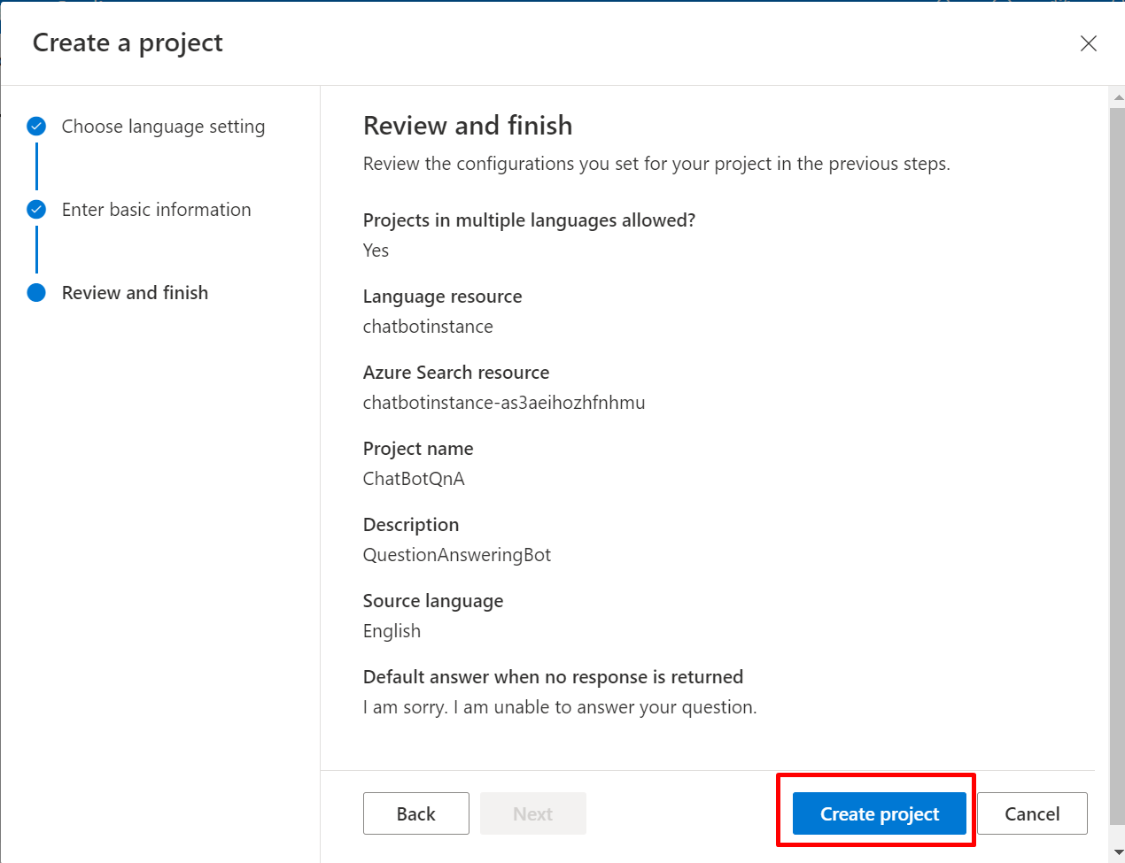
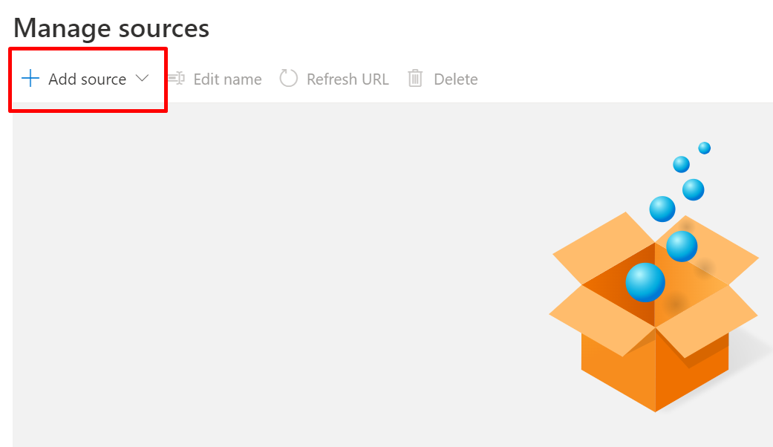
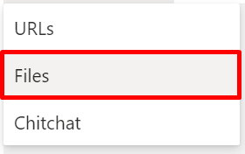
9
10
9. Select the language for the project
10. Enter basic information like Name, Source Language and default answer
11
12
11. Review all the information regarding the project and hit ‘Create project’
12. Click on ‘Add source’ for adding the sources

Slide 8
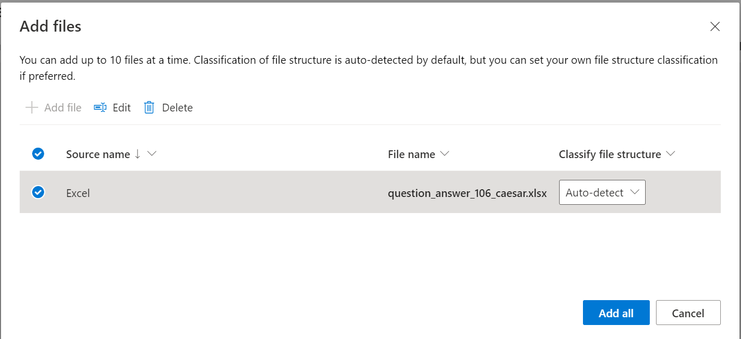
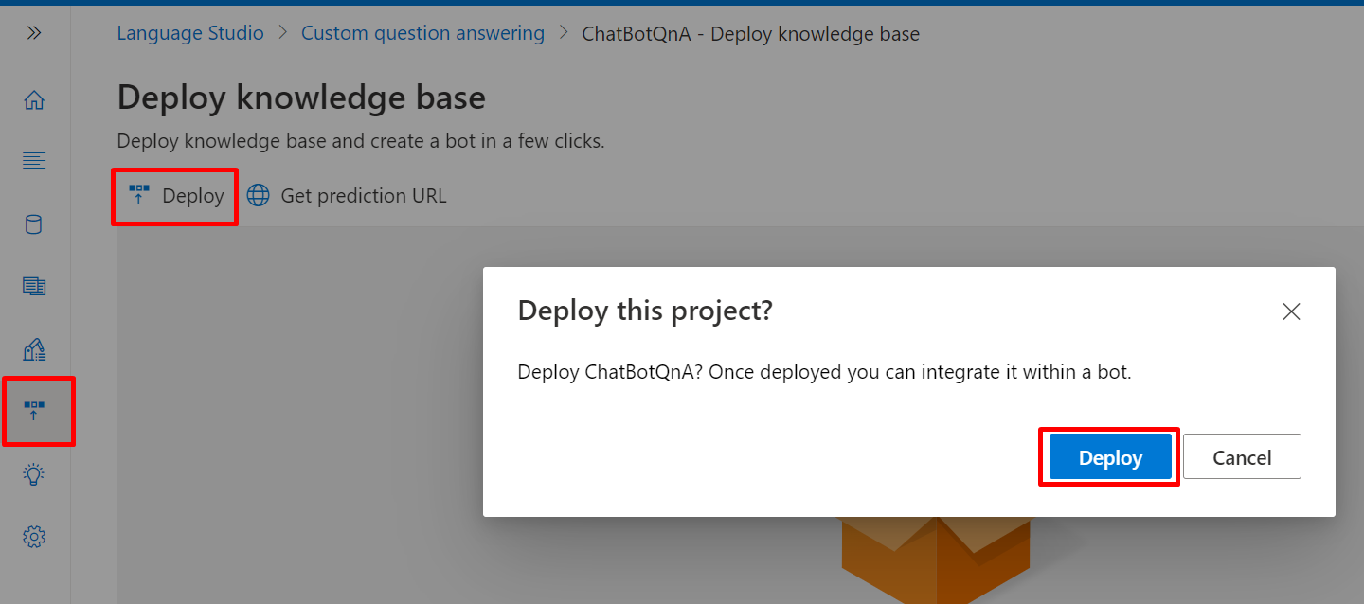
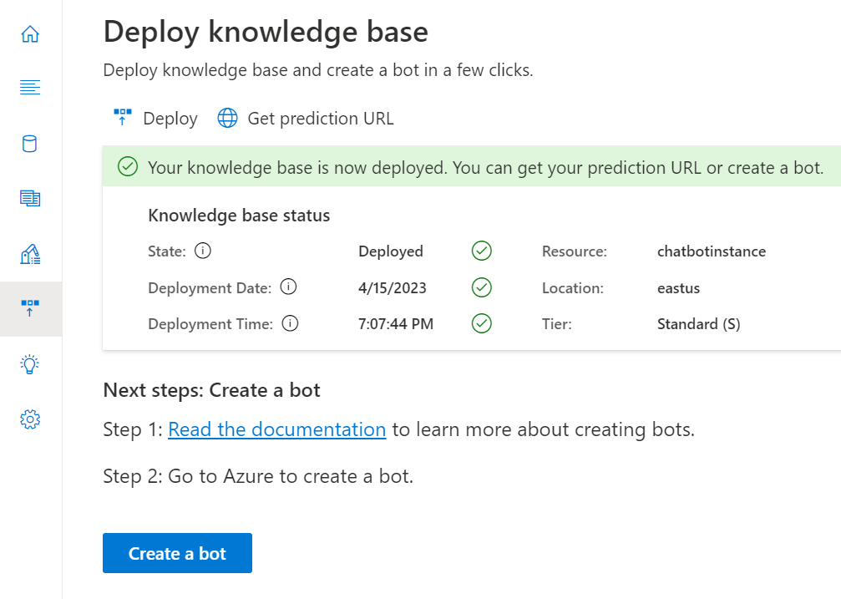
13
14
13. Then upload your excel files having all the questions and their respective answers
14. Go to ‘Deploy knowledge base’ -> ‘Deploy’ and then select ‘Deploy’ in the pop-up
15. After deploying your knowledgebase, you’re ready to create a bot
15

Slide 9
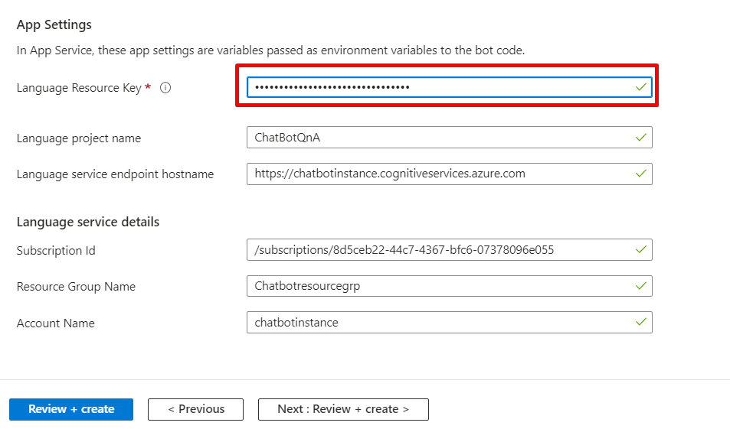
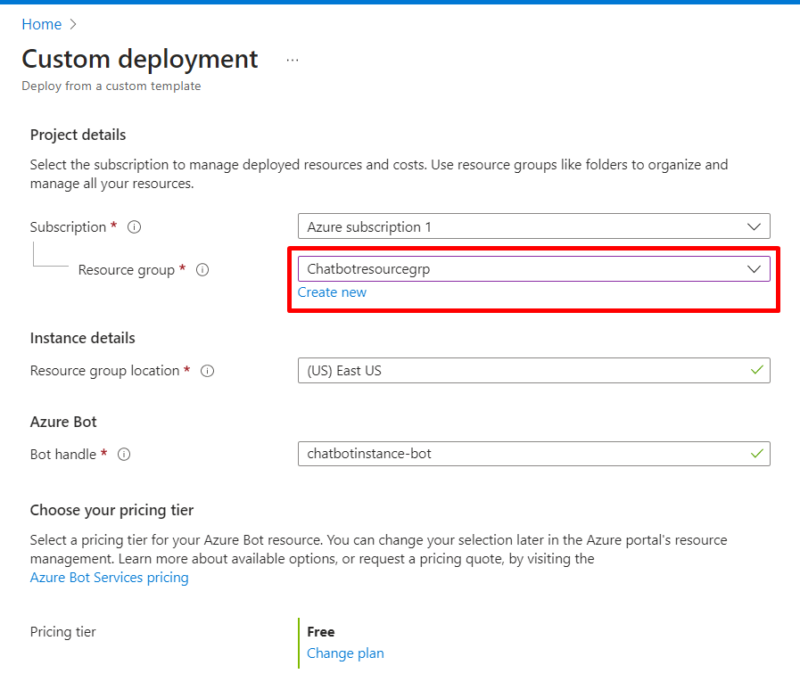

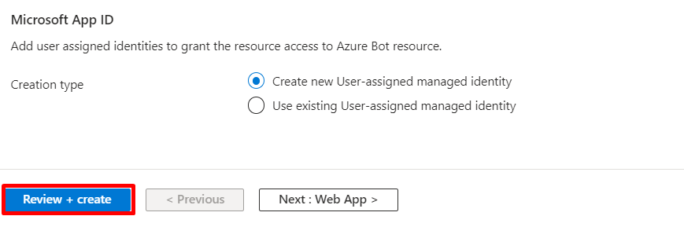
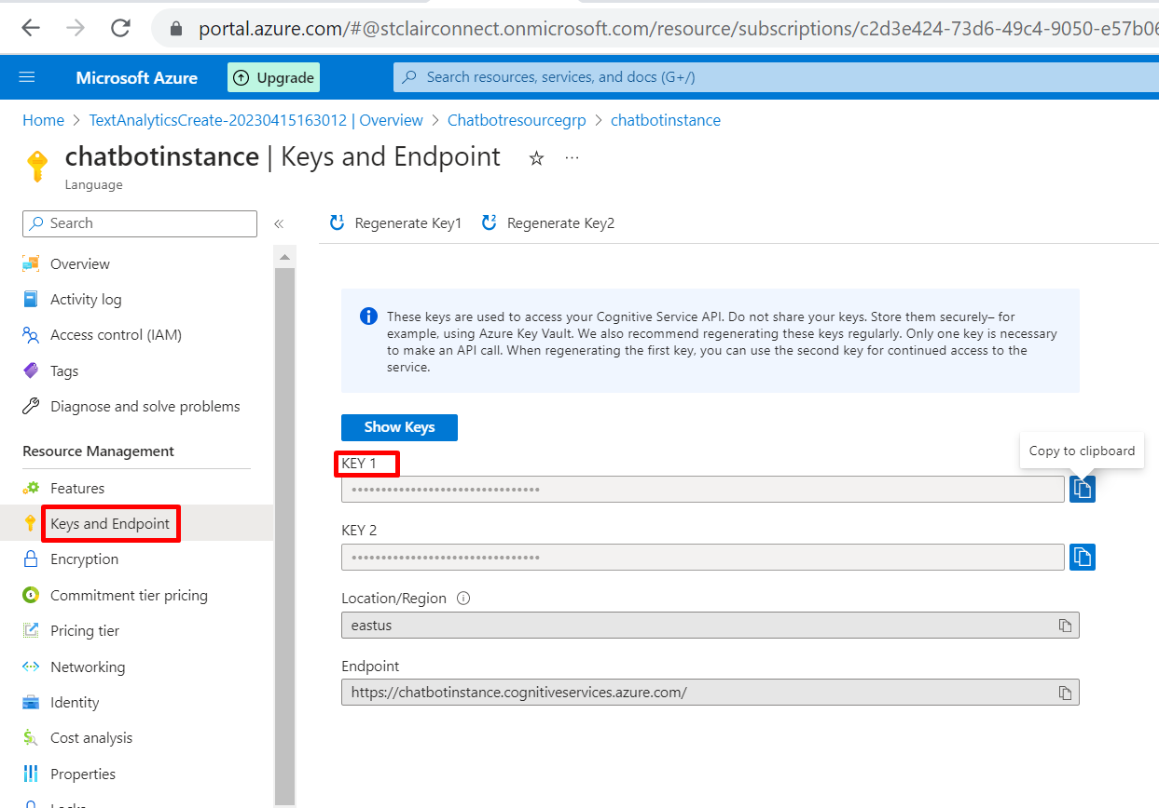
17
16
16. Enter Project details for Bot creation.
17. Enter ‘language resource key’, using key of the language resource group which we already created in the beginning
18

Slide 10
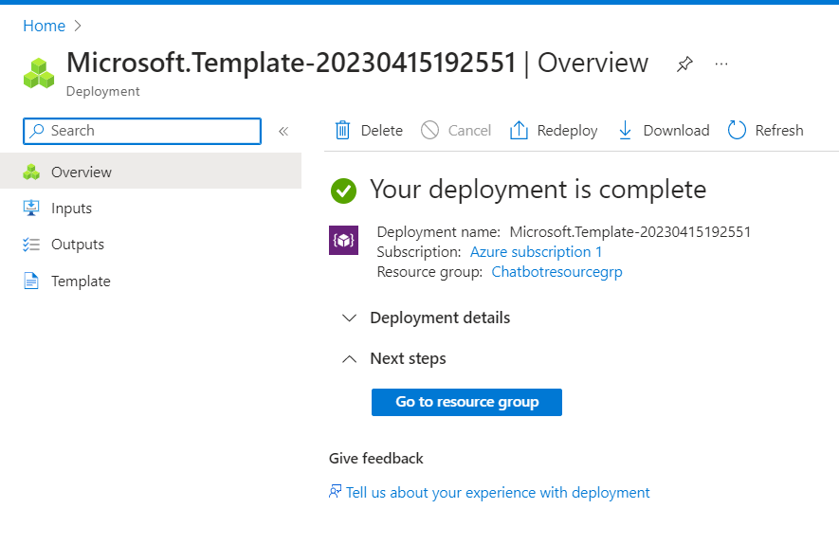
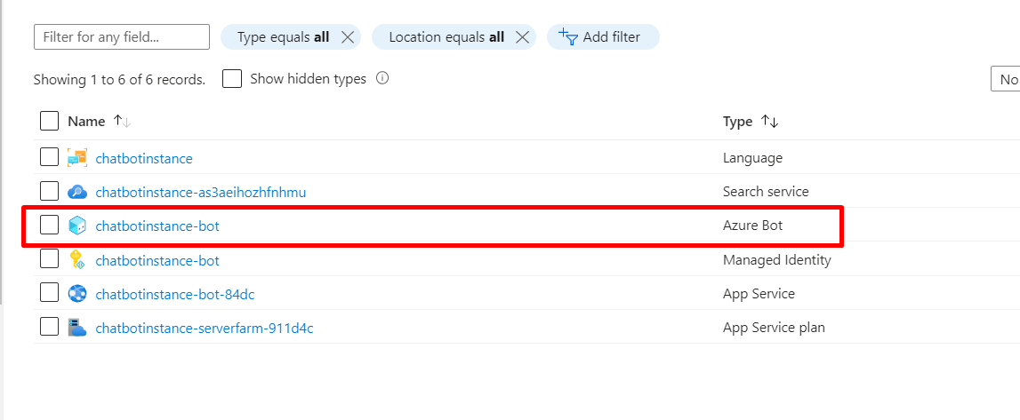
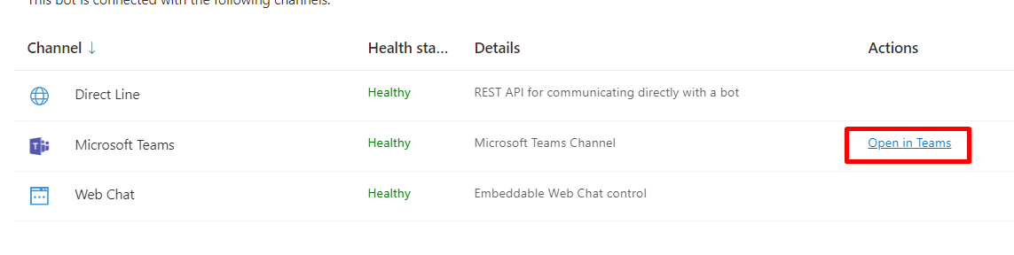
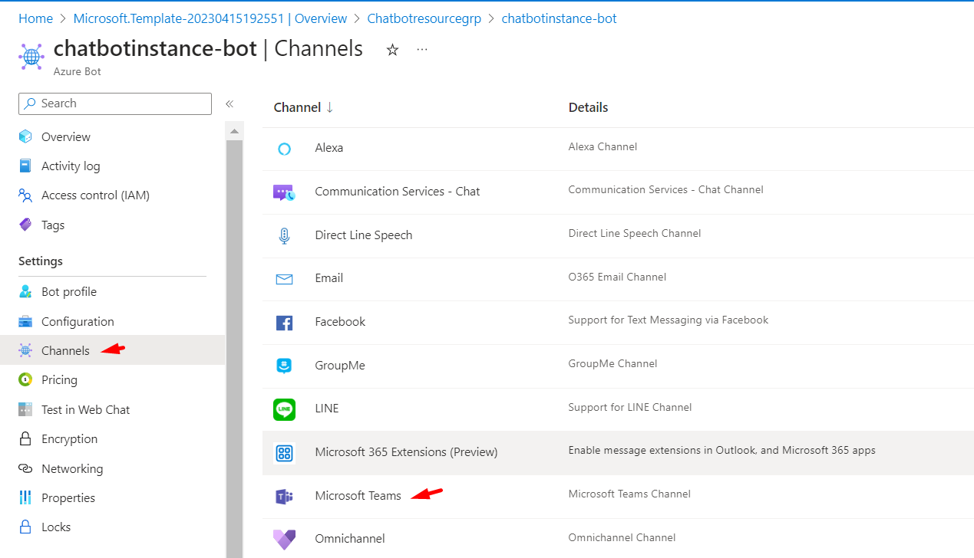
19
20
22
21
19. After deployment is complete, go to resource group
20. Select Azure bot which you have created
21. Go to channels and select where you want it to link
22. And at last open that channel

Slide 11


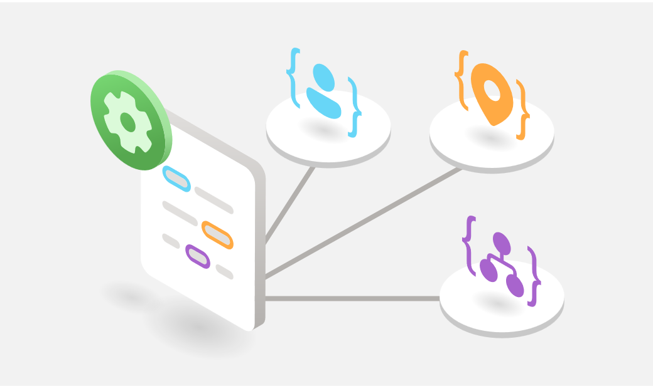



CHALLENGESLLENGES
SOLUTIONS
Finding an alternative to qnamaker.ai
Understanding Language studio
Linking the bot with Azure resource
Creating knowledgebase for the bot
Language studio
Microsoft Documentation
Research and Documentation
Excel Files

Slide 12
LIMITATIONS
Does not support any other language except: English
No personalized responses
Limited Questions and Answers

Slide 13





CONCLUSION
Instant responses
Scope of Improvements:
Integration with LUIS
Using NLP
Multi-Lingual
24X7 services
Serve multiple customers at same time
Enhance customer experience

